Slide 1
Welcome
Theory of Production

Slide 2
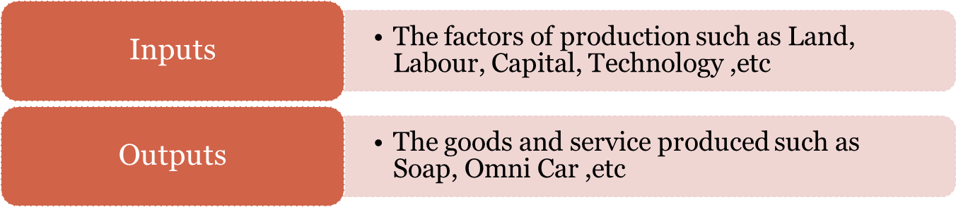
Theory of Production
Production is a process that create/adds value or utility
It is the process in which the inputs are converted in to outputs.

Slide 3

Production Function
Production function means the functional relationship between inputs and outputs in the process of production.
It is a technical relation which connects factors inputs used in the production function and the level of outputs
Q = f (Land, Labour, Capital, Organization, Technology, etc)

Slide 4
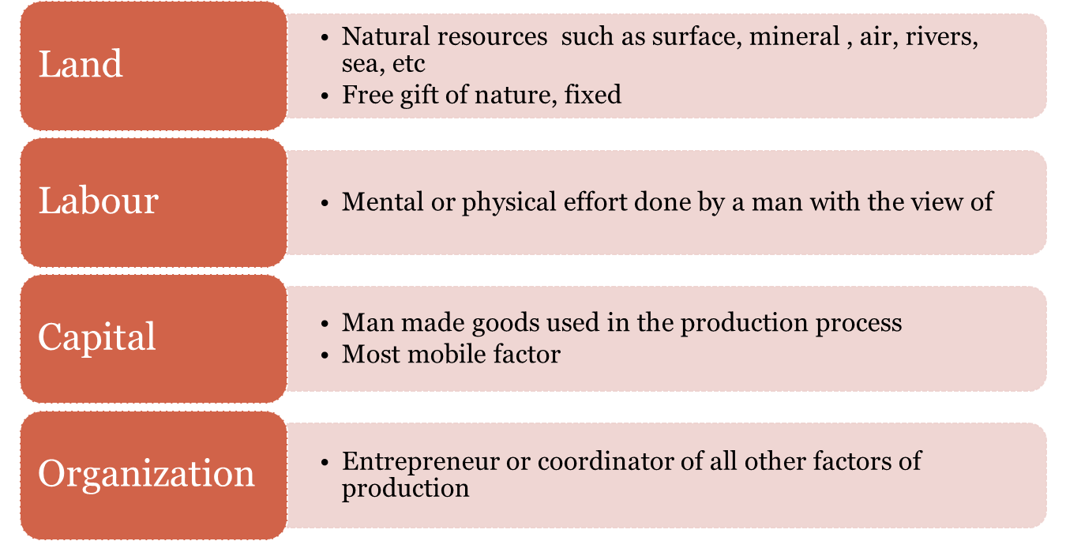
Factors of Production

Slide 5
Inputs : Fixed inputs and Variable inputs
The factors of production that is carry out the production is called inputs.
Land, Labour, Capital, Organizer, Technology, are the example of inputs
Inputs Factors
Variable inputs
Fixed Inputs

Slide 6
Inputs : Fixed inputs and Variable inputs
Fixed inputs
Remain the same in the short period .
At any level of out put, the amount is remain the same.
The cost of these inputs are called Fixed Cost
Examples:- Building, Land etc
( In the long run fixed inputs are become varies)
Variable inputs
In the long run all factors of production are varies according to the volume of outputs.
The cost of variable inputs is called Variable Cost
Example:- Raw materials, labour, etc

Slide 7
Various concept of production
Total Product
Average Product- Ratio of Total Product and one variable
inputs
Marginal Product – Change of out put as a
result changes in one variable input

Slide 8

Production with One Variable Input
Short run Production Function with Labour as Variable factor
Labour (L)
Capital (K)
Total Output (TP)
Average Product (AP)
Marginal Product
(MP)
0
1
2
3
4
5
6
7
8
9
10
10
10
10
10
10
10
10
10
10
10
10
0
10
30
60
80
95
108
112
112
108
100

Slide 9
Production with One Variable Input
Short run Production Function with Labour as Variable factor
Labour (L)
Capital (K)
Total Output (TP)
Average Product
(AP)
Marginal Product
(MP)
0
1
2
3
4
5
6
7
8
9
10
10
10
10
10
10
10
10
10
10
10
10
0
10
30
60
80
95
108
112
112
108
100
-
10
15
20
20
19
18
16
14
12
10
10
20
30
20
15
13
4
0
-4
-8

Slide 10
Law of Production Function
Laws of Variable proportion- Law of Diminishing Return ( Short run production function with at least one input is variable)
Laws of Return scales – Long run production function with all inputs factors are variable.

Slide 11
Law of variable proportion: Short run Production Function
Explain short run production function
Production function with at least one variable factor keeping the quantities of others inputs as a Fixed.
Show the input-out put relation when one inputs is variable
“If one of the variable factor of production used more and more unit,keeping other inputs fixed, the total product(TP) will increase at an increase rate in the first stage, and in the second stage TP continuously increase but at diminishing rate and eventually TP decrease.”

Slide 12
Law of Variable Proportions
Increasing Returns to the Variable Factor: very first stage. MP>0 and MP>AP
Diminishing Returns to a Variable Factor: the second stage. MP>0 and MP<AP
Negative Returns: technically inefficient stage of production and a rational firm will never operate in this stage. MP<0 while AP is falling but positive.
Total Output
C
B
TP_{L}
Panel a
A
O
Total Output
Labour
Stage I
Stage II
Stage III
A*
B*
Panel b
AP_{L}
C*
O
MP_{L}
Labour

Slide 13
Production with One Variable Input
Short run Production Function with Labour as Variable factor
Labour (L)
Capital (K)
Total Output (TP)
Average Product
(AP)
Land
Marginal Product
(MP)
0
1
2
3
4
5
6
7
8
9
10
10
10
10
10
10
10
10
10
10
10
10
10
10
10
10
10
10
10
10
10
10
10
0
10
30
60
80
95
108
112
112
108
100
-
10
15
20
20
19
18
16
14
12
10
10
20
30
20
15
13
4
0
-4
-8
First Stage
Second Stage
Third Stage

Slide 14
D
112
Output per month
Total Product
C
60
B
A
Labor per month
3
4
8
30
E
20
Average product
10
3
4
Labor per month
8
Marginal product

Slide 15
Stages in Law of variable proportion
First Stage: Increasing return
TP increase at increasing rate till the end of the stage.
AP also increase and reaches at highest point at the end of the stage.
MP also increase at it become equal to AP at the end of the stage.
MP>AP
Second Stage: Diminishing return
TP increase but at diminishing rate and it reach at highest at the end of the stage.
AP and MP are decreasing but both are positive.
MP become zero when TP is at Maximum, at the end of the stage
MP<AP.
Third Stage: Negative return
TP decrease and TP Curve slopes downward
As TP is decrease MP is negative. AP is decreasing but positive.

Slide 16
Where should rational firm produce?

Slide 17
Where should rational firm produce?
Stage I: MP is above AP implies an increase in input increases output in greater proportion.
The firm is not making the best possible use of the fixed factor.
So, the firm has an incentive to increase input until it crosses over to stage II.
Stage III: MP is negative implies contribution of additional labor is negative so the total output decreases .
In this case it will be unwise to employ an additional labor.

Slide 18
Stage II: MP is below AP implies increase in input increases output in lesser proportion.
A rational producer/firm should produce in stage II.
But where exactly the firm will operate within stage II cannot be determined only on the basis of the product curves.
We need information about input costs and price of output.

Slide 19
2. Law of return to scales: Long run Production Function
Explain long run production function when the inputs are changed in the same proportion.
Production function with all factors of productions are variable..
Show the input-out put relation in the long run with all inputs are variable.
“Return to scale refers to the relationship between changes of outputs and proportionate changes in the in all factors of production ”

Slide 20
Law of return to scales: Long run Production Function
Labour | Capital | TP | MP
2 | 1 | 8 | 8
4 | 2 | 18 | 10
6 | 3 | 30 | 12
8 | 4 | 40 | 10
10 | 5 | 50 | 10
12 | 6 | 60 | 10
14 | 7 | 68 | 8
16 | 8 | 74 | 6
18 | 9 | 78 | 4
Increasing returns to scale
Constant returns to scale
Decreasing returns to scale

Slide 21
Law of return to scales: Long run Production Function
Inputs 10% increase – Outputs 15% increase
Increasing returns to scale
Inputs 10% increase – Outputs 10% increase
Constant returns to scale
Inputs 10% increase – Outputs 5% increase
Decreasing returns to scale

Slide 22
Homogeneous production function
In the long run all inputs are variable. The production function is homogeneous if all inputs factors are increased in the same proportions in order to change the outputs.
A Production function Q = f (L, K )
An increase in Q> Q^ = f (L+L.10%, K+K.10% )-
Inputs increased same proportion
Increasing returns to scale
Inputs increased 10% => output increased 15%
Constant returns to scale
Inputs increased 10% => output increased 10%
Decreasing returns to scale
Inputs increased 10% => output increased 8%

Slide 23
Linearly Homogeneous production function
In the long run all inputs are variable. The production function is Linearly homogeneous if all inputs factors are increased in the same proportions and the output is increased in the same proportion.
Constant returns to scale Homogeneous production function
Inputs increased 10% => output increased 10%
A Linearly homogeneous Production function Q = f (L, K )
if labour and capital increased 10% then output increased the same 10%

Slide 24
Linearly Homogeneous production function
A Linearly homogeneous Production function Q = f (L, K )
if labour and capital increased 10% then output increased the same 10%
400 unit output
%changes in factor
Capital
300 unit output
200 unit output
100 unit output
%changes in factor Labour

Slide 25
Iosquants
Combination | Labour | Capital | Output level
A | 20 | 1 | 100 unit
B | 18 | 2 | 100 unit
C | 12 | 3 | 100 unit
D | 9 | 4 | 100 unit
E | 6 | 5 | 100 unit
F | 4 | 6 | 100 unit
An isoquants represent all those possible combination of two inputs (labour and capital), which is capable to produce an equal level of output .

Slide 26
Iosquants
Isoquants or equal product curve
Capital
100 unit output
Labour
An isoquants represent all those possible combination of two inputs (Labour and Capital), which is capable to produce an equal level of output.

Slide 27
Marginal Rate Technical Substitute(MRTS)
Isoquants or equal product curve
Capital
100 unit output
Labour
The slop of isoquant is known as Marginal Rate of Technical Substitution (MRTS). It is the rate at which one factors of production is substitute with other factor so that the level of the out put remain the same.
MRTS = Changes in Labour / changes in capital

Slide 28
Welcome
Theory of Production

